Slide 1



Our Team:
Mohamed Ehab Turky
Mona Mohamed Elsayed
Team Leader
Menna Allah Haitham Shafeeq
Mostafa Mohamed Mostafa
Belal Ahmed Eid
Yassin Mohy Eldeen

Slide 2

Data Governance:
Protecting Data, Protecting Trust
In today's data-driven world, effective data governance is not merely a technicality but a strategic imperative. This presentation will explore the critical role of data governance in safeguarding sensitive information and building enduring trust with stakeholders. We will define its core principles, highlight its importance, and delve into a significant case study—the Equifax data breach—to illustrate the profound consequences of neglecting robust data governance practices.

Slide 3
What is Data Governance?
1
Structured Framework
2
Holistic Management
3
Foundational Pillar
A comprehensive framework encompassing policies, processes, roles, and standards designed to ensure data is accurate, secure, and used responsibly across the organization.
Enables organizations to effectively manage critical aspects such as data quality, privacy, compliance, and risk, fostering a robust data environment.
Serves as a critical foundation for informed decision-making, ensuring regulatory adherence, and fostering unwavering stakeholder trust.
Data governance establishes the rules of engagement for all data within an organisation, from its creation to its eventual disposal. It creates clarity, accountability, and a shared understanding of data's value and risks.

Slide 4

Why Data Governance Matters
Neglecting strong data governance can lead to serious consequences, including:
Data Breaches: Unauthorised access to sensitive information, compromising privacy.
Financial Loss: Costly remediation, fines, and legal settlements.
Reputational Damage: Erosion of customer trust and brand credibility.
Legal Penalties: Non-compliance with strict data protection regulations.
Effective data governance is the bedrock of data integrity, enabling precise business insights and streamlined operational efficiency. It ensures compliance with pivotal regulations such as GDPR and CCPA, safeguarding both the organisation and its clientele.

Slide 5
Key Components of Data Governance
Data Quality
1
Ensuring the accuracy, completeness, and consistency of data across all systems.
Data Stewardship
2
Designating individuals or teams accountable for the proper management and oversight of specific data assets.
Data Policies & Standards
3
Establishing clear rules and guidelines governing data access, usage, and protection throughout the organisation.
Data Security
4
Applying strong security measures and controls to protect data from unauthorised access, disclosure, alteration, or destruction.
Data Lifecycle Management
5
Managing data from its creation to its eventual archiving or deletion, ensuring compliance and efficiency at every stage.

Slide 6
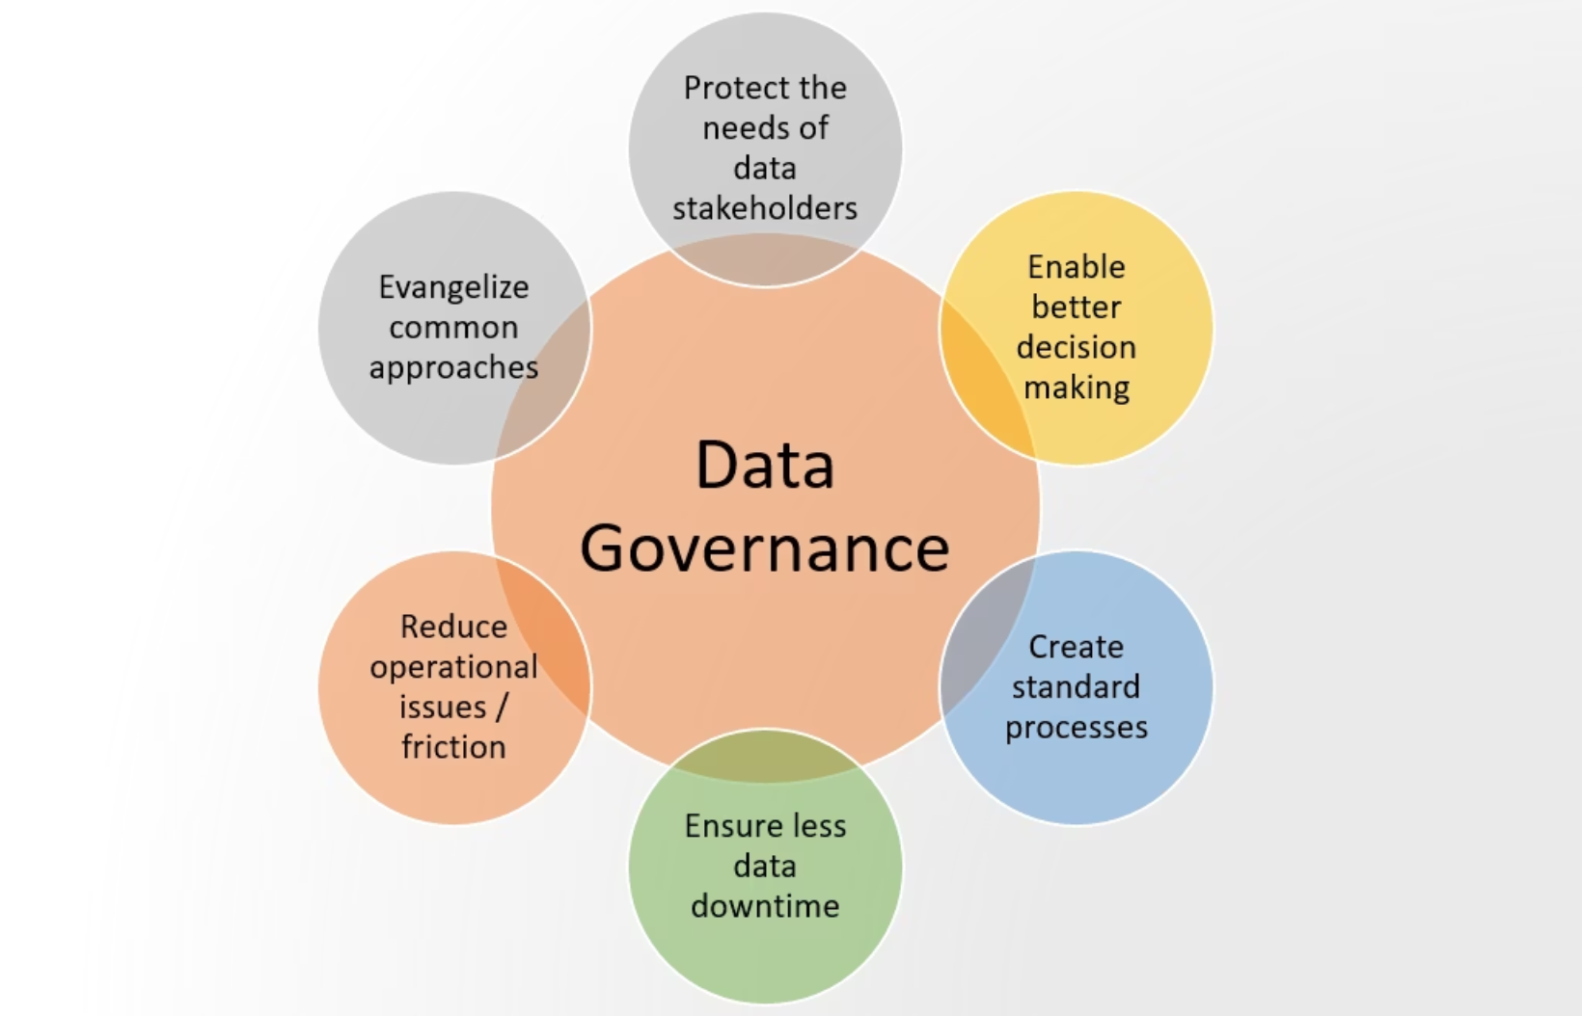

Goal & Importance of Data Governance
The primary goal of data governance is to maintain safe, high-quality, and easily accessible data for critical business intelligence initiatives and informed decision-making.
It acts like an air traffic control hub, ensuring that verified data flows through secured pipelines to trusted endpoints and authorized users. This minimizes data inconsistencies, reduces compliance risks, and fosters a data-driven culture.

Slide 7
Data Governance vs. Data Management
While often used interchangeably, data governance and data management play distinct yet complementary roles in a healthy data ecosystem.
Data Governance
Data Management
Defines the rules, policies, and standards for data
Executes the day-to-day activities to handle data
Focuses on decision-making, accountability, and compliance
Focuses on collecting, storing, processing, and delivering data
Answers "Who can do what with data?"
Answers "How is data stored, moved, and used?"
Strategic – sets the framework
Operational – applies the framework
Owned by business leaders & governance bodies
Owned by IT, data engineers, analysts

Slide 8
Key Pillars of a Data Governance Framework
01
02
03
Policies & Standards
Roles & Responsibilities
Processes
Establish clear guidelines for data quality, privacy, security, and usage across all departments.
Define accountability: Data Owners (accountable for data), Data Stewards (ensure quality & compliance), and Data Custodians (manage storage & infrastructure).
Implement structured procedures for data lifecycle management, including collection, storage, access & sharing, archiving, and deletion.
04
05
Technology & Tools
Metrics & KPIs
Utilize data catalogs, quality monitoring systems, metadata management tools, and other platforms to support governance efforts.
Define measurable indicators such as data quality scores and compliance rates to track success and identify areas for improvement.

Slide 9
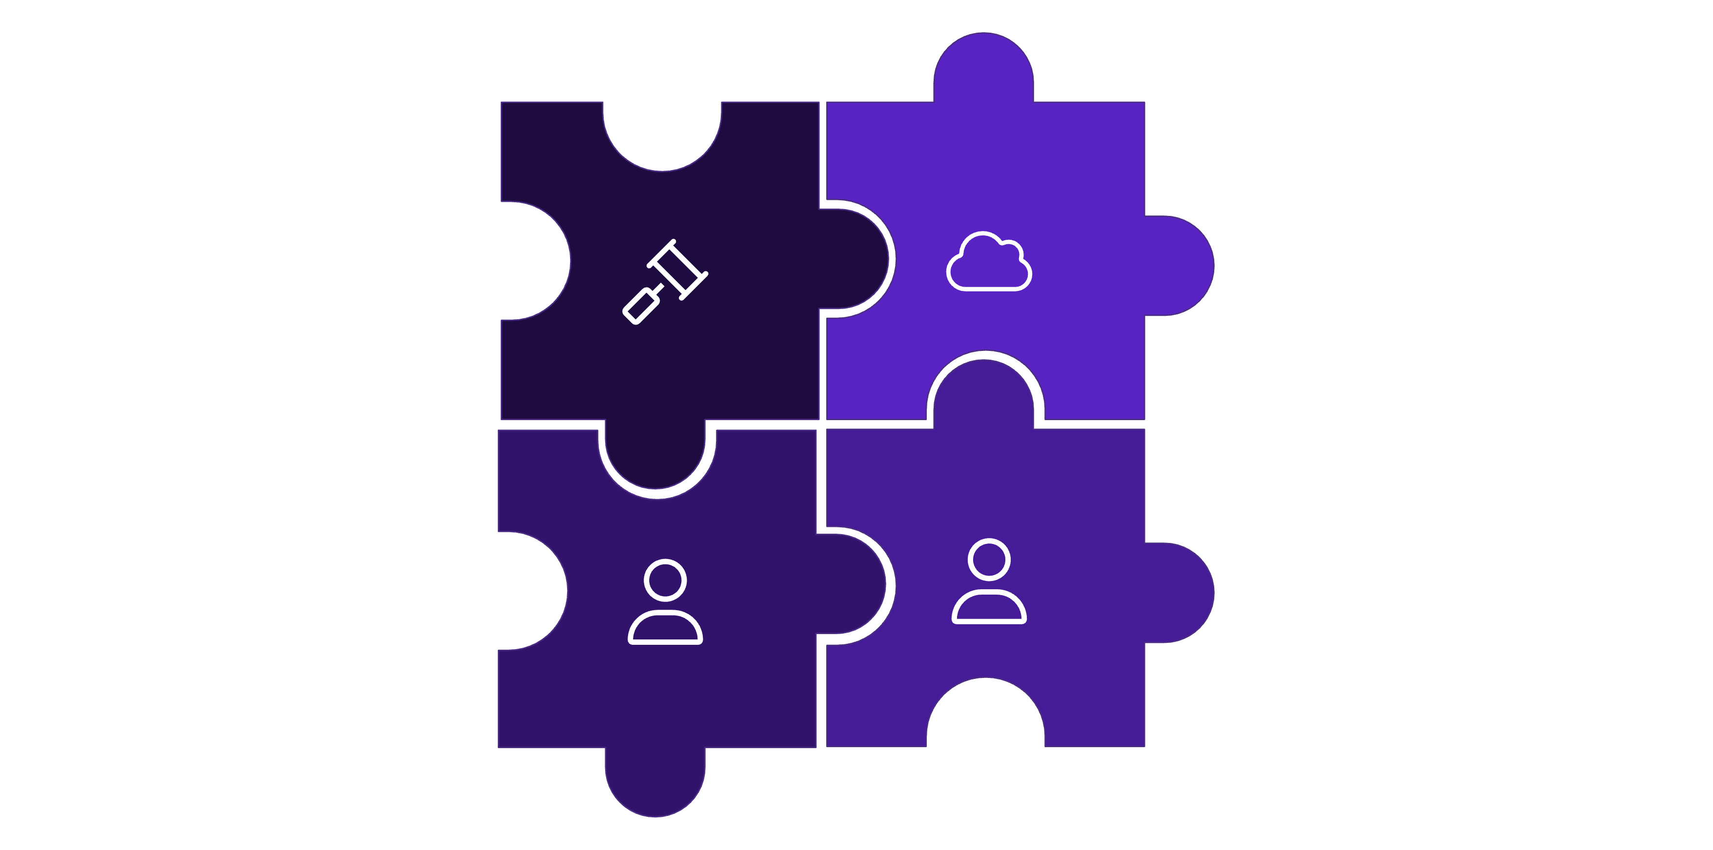



Structuring Your Data Governance Framework
Policies
Technology
Roles
Processes
A robust data governance framework integrates various components to ensure data integrity and compliance. These interlocking pieces ensure that data is treated as a valuable asset throughout its lifecycle.

Slide 10



Best Practices in Data Governance
Adopting a proactive approach to data governance is essential for long-term success and security. These practices form the backbone of a resilient data environment.
Clear Accountability
Regular Audits
Strict Controls
Establish clear ownership and accountability for data management at all organisational levels.
Implement consistent data quality audits and continuous monitoring processes to identify and resolve issues promptly.
Enforce stringent access controls and robust encryption mechanisms to protect sensitive data.
Vulnerability Management
Culture of Responsibility
Maintain up-to-date patch management and comprehensive vulnerability scanning protocols.
Foster a strong organisational culture of data responsibility through continuous training and awareness programmes.

Slide 11

Case Study: Equifax Data Breach
Equifax:
A major American credit reporting company, storing data on 800+ million consumers.
Plays a central role in lending and financing decisions.
In 2017, Equifax, suffered a catastrophic data breach that exposed the sensitive personal data of approximately 147 million individuals. This breach became a reminder of the critical importance of data governance.
Key Factors Behind the Breach:
Exploited Vulnerability: A vulnerability in Apache Struts discovered in March but left unpatched.
Undetected Access: Attackers maintained prolonged, undetected access due to inadequate monitoring
Compromised Data: The breach compromised names, Social Security numbers, birth dates, addresses, driver’s license numbers, and credit card details.
This incident served as a wake-up call for organisations worldwide, highlighting the devastating impact of governance failures.

Slide 12

Impact & Data Governance Failures
Far-Reaching Consequences
Major Governance Gaps
Lack of Patch Management: No clear policies for timely application of security updates, leaving known vulnerabilities exposed.
Financial Losses: Over $700 million in legal settlements and fines.
Erosion of Trust: Significant loss of customer and public trust, severely damaging Equifax's market reputation.
Insufficient Monitoring: Failure to implement continuous monitoring systems meant the breach went undetected for months.
Regulatory Scrutiny :Triggered extensive government audits and led to stricter data protection laws.
Poor Data Classification: Highly sensitive personal data was not adequately classified or secured.

Slide 13
Lessons Learned & The Importance of Data Governance
Key Lessons from Equifax
Why Data Governance Matters
Prioritize Security Updates: Immediate patching of vulnerabilities is non-negotiable.
Ensures Data Quality: Maintains accuracy and consistency.
Enforce Access Controls: Strict policies defining who can access which data are essential.
Protects Data Security: Prevents unauthorized access and data loss.
Implement Incident Response: A well-defined plan for detecting, responding to, and recovering from breaches.
Guarantees Compliance: Adherence to regulations and other industry-specific mandates.
Employee Training: Continuous education on data protection best practices for all personnel.
Builds Trust: Safeguards the organization's credibility and fosters long-term customer relationships.

Slide 14

"The absence of strong governance doesn't just cost money… it can destroy an organization's reputation in a single day."

Slide 15


Thank you for your time!

